Slide 1

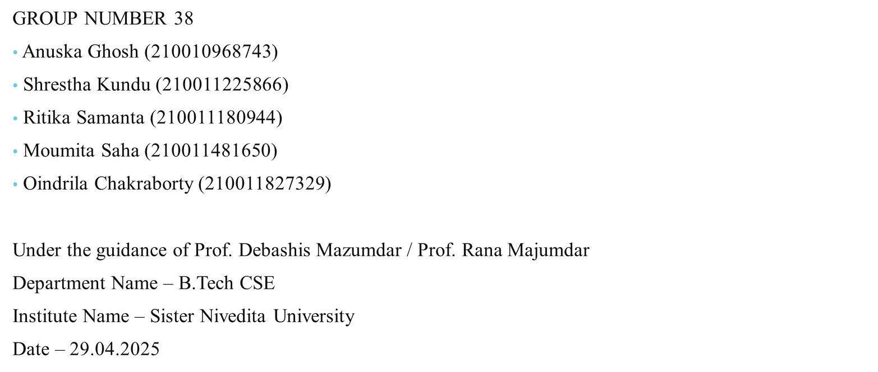
Use of Twitter Data to Model and Forecast Election Result : Brief Review

Slide 2
Contents
Introduction
Objectives
Literature Survey
Proposed Solution/Methodology
Implementation
Result/Output
Challenges Faced
Conclusion
References
Acknowledgment
Q/A

Slide 3
Introduction
Project Overview:
Analyze Twitter data to predict 2024 Lok Sabha election outcomes in West Bengal using sentiment analysis.Focus on four key parties: TMC, BJP, Congress, and CPM.
Motivation / Background:
Social media, especially Twitter, has become a key platform for political expression and public discourse. It offers real-time, large-scale insights that complement traditional polling methods.
Problem Statement:
There is a need to systematically interpret social media data for accurate election forecasting. This project aims to bridge that gap by building a data-driven model to assess public sentiment and predict voter trends.

Slide 4
Objectives
Primary Objectives
Predict voting outcomes based on Twitter sentiment.
Perform rule-based sentiment analysis.
Understand public opinion trends for parties/candidates.
Secondary Objectives
Analyze tweet sentiment using sentiment dictionary.
Identify the party with the highest public support.
Scope
Analyze Twitter data using a lexicon-based method to calculate sentiment scores and visualize trends via curve graphs.

Slide 5
Literature Survey
Summary of related work
Skoric et al. (2012) – Analyzed Twitter sentiment during the 2011 Singapore General Election. Their rule-based sentiment analysis closely matched the actual election outcomes, demonstrating Twitter’s potential as a predictor of public opinion.
Ahmed & Skoric (2014) – Studied the 2013 Pakistan General Election using Twitter data. They found that tweet volume and sentiment analysis could effectively capture public engagement and predict political trends.
Gaps Identified
No specific sentiment analysis work found for West Bengal elections using Twitter data.
Existing studies mostly focus on national-level elections (e.g., India, Pakistan).
Lack of region-specific public sentiment scoring and visualization for state-level political analysis.

Slide 6
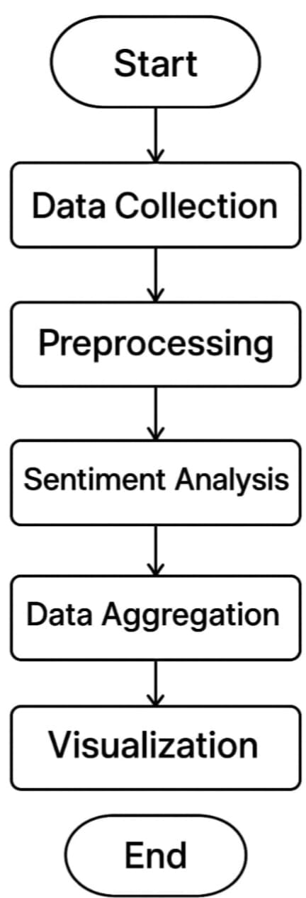
Proposed System / Methodology
Project Workflow
Data Collection
→ Manually created a synthetic dataset of tweets related to West Bengal elections
Preprocessing
→ Cleaned data by removing stopwords, links, emojis, etc.
Sentiment Analysis
→ Applied a lexicon-based method to detect sentiment polarity
Party-wise Scoring
→ Mapped tweets to parties and calculated cumulative sentiment scores
Visualization
→ Displayed sentiment trends using curve graphs

Slide 7
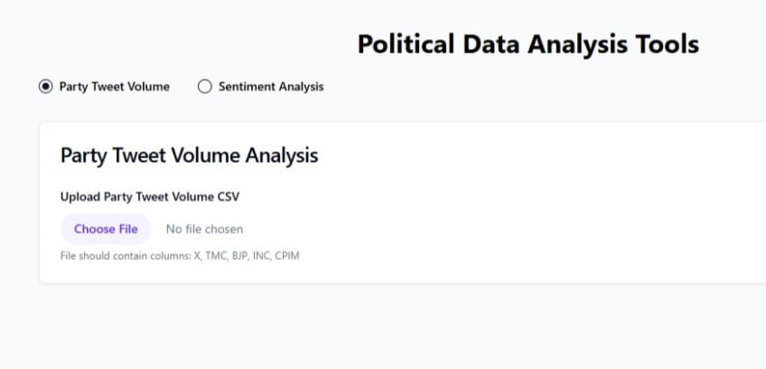
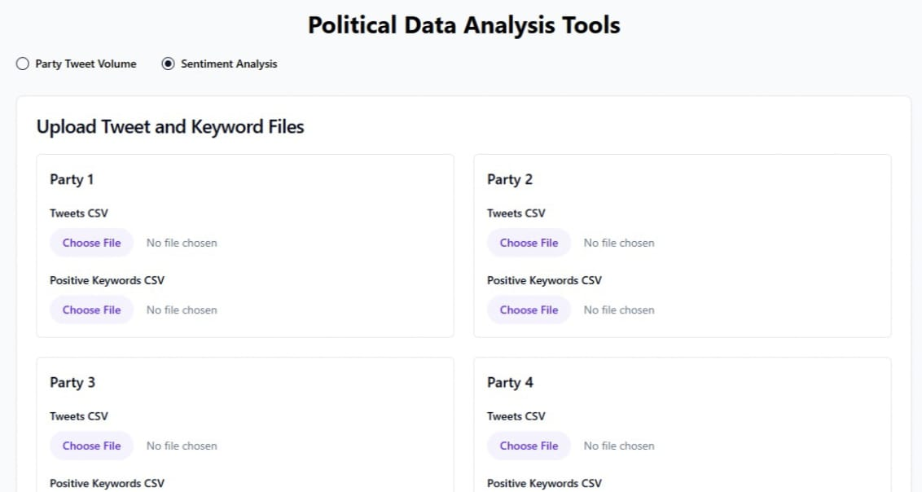
Implementation
Modules / Stages of Development
Frontend
→ Users can upload their own dataset on the website.
→ The website displays party tweet volume and sentiment analysis results. React js has been used for creating the app. Recharts has been used for graphs and charts. For UI framework Tailwind CSS has been used for the designing part.

Slide 8
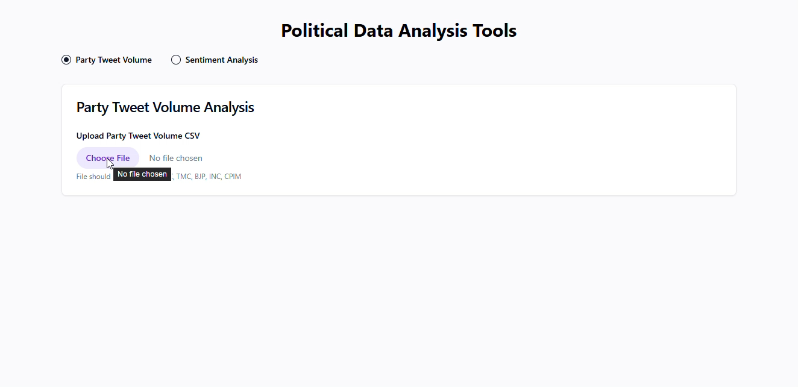

Slide 9
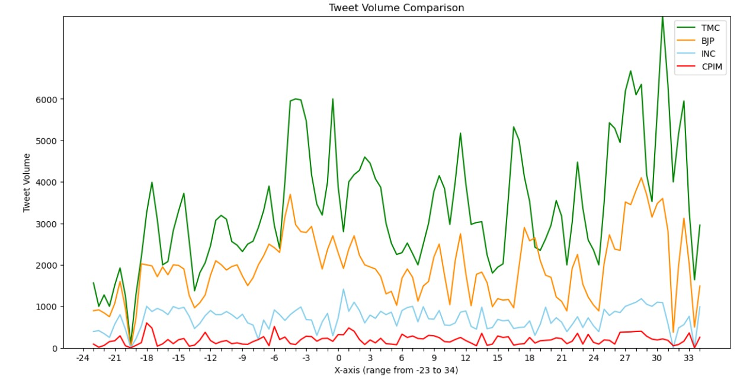
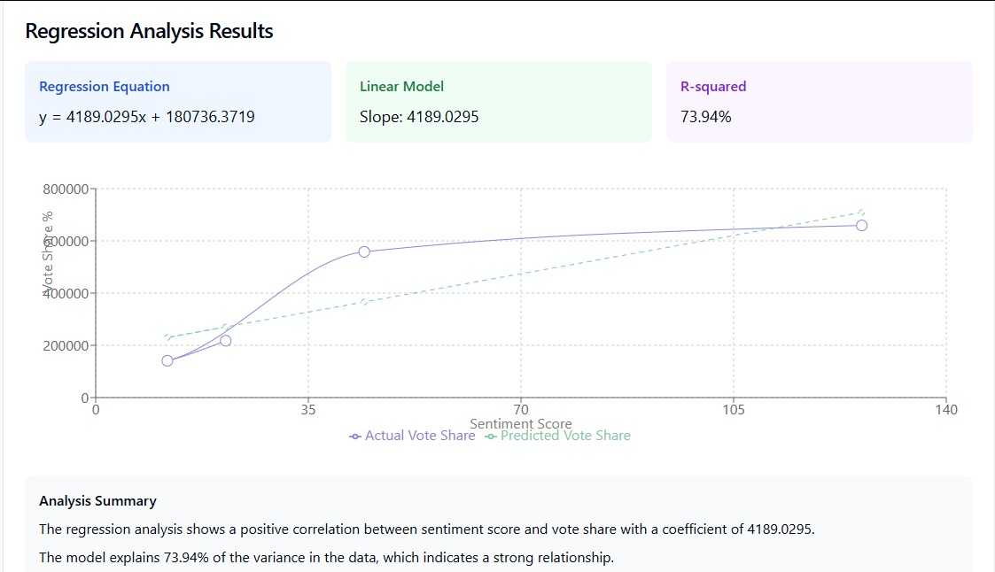
Results / Output

Slide 10
Challenges Faced
Technical Challenges
Twitter API Limitations
Challenge: Unable to access live tweet data due to Twitter’s new restrictions.
Solution: We manually created a synthetic dataset based on election-related tweets.
Language Barriers
Challenge: Some tweets were in Hindi and regional languages, making sentiment analysis difficult.
Solution: We translated all non-English tweets into English using translation tools to standardize the dataset.
Non-Technical Challenges
Time-Consuming Dataset Creation
Challenge: Manually curating and labeling the dataset was resource-intensive.
Solution: We dedicated additional time for manual data collection and ensured careful labeling to maintain quality.

Slide 11
Conclusion and Future Work
Summary of Outcomes
We used linear regression on historical data and compared tweet volumes for TMC, BJP, CPIM, and Congress to predict election outcomes by combining past trends with real-time social media sentiment.
Limitation
Limited Representation: Twitter data may not reflect the opinions of the broader population, especially rural or older demographics not active on social media.
2. Sentiment Misinterpretation: Sarcasm, slang, and mixed-language tweets can lead to inaccurate sentiment classification, affecting prediction reliability.
Suggestions for future enhancement
The project can evolve by expanding to other platforms like Facebook and Instagram, integrating deep learning models (BERT, GPT) for better sentiment analysis, and incorporating demographic and geographic data for more accurate and realistic election predictions.

Slide 12
References
Ahmed, S., & Skoric, M. M. (2014). My name is Khan: the use of Twitter in the campaign for 2013 Pakistan General Election. 47th Hawaii International Conference on System Sciences (HICSS), IEEE.
Skoric, M., Poor, N., Achananuparp, P., Lim, E. P., & Jiang, J. (2012). Tweets and votes: A study of the 2011 Singapore general election. 45th Hawaii International Conference on System Sciences (HICSS), IEEE.
Hu, M., & Liu, B. (2004). Mining and summarizing customer reviews. Proceedings of the 10th ACM SIGKDD International Conference on Knowledge Discovery and Data Mining, 168–177. ACM.

Slide 13
Acknowledgment
We would like to express our heartfelt gratitude to Prof. Debashis Mazumdar and Prof. Rana Majumdar for their continuous guidance, encouragement, and support throughout the course of this project. Their insights and mentorship have been invaluable to our work.

Slide 14
Q&A
Thank you!
Any questions?

